Slide 1
Reinforcement Learning
Lectures 4-5
By:
Ms. Sara Rehmat

Slide 2
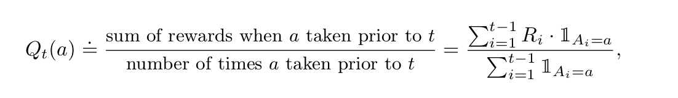
Multi-armed bandits
On each of a sequence of time steps,t=1,2,3,..., you choose an action A_{t} from k possibilities, and receive a real-valued reward R_{t}
The true values of actions are unknown.
Values of actions are estimated using action-value method.
Action value method uses estimates the value of action using average of the sample of relevant rewards.

Slide 3
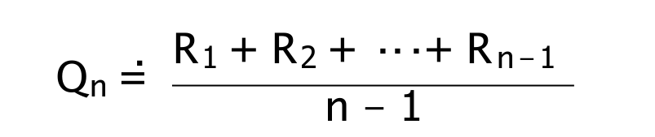
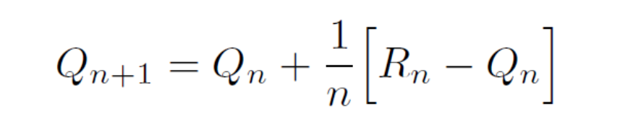
Incremental Implementation of Action-value method
In sample average method, we find estimates of action values by the following method:
How can we do this incrementally (without storing all the rewards)?
Could store a running sum and count (and divide), or equivalently:
NewEstimate = OldEstimate + StepSize * (Target - OldEstimate)

Slide 4
Incremental Implementation of Action-value method
The expression Target-OldEstimate is an error in the estimate. It is reduced by taking a step toward the “Target.”
The target is presumed to indicate a desirable direction in which to move, though it may be noisy. In the case above, for example, the target is the nth reward.

Slide 5
Example of incremental update method for estimating action values
Step | Action taken | Reward (R) | Previous Estimate | Updated Estimate
1 | A1 | 2 | 0
2 | A2 | 5 | 0
3 | A1 | 4 | 2
4 | A3 | 1 | 0
5 | A1 | 3 | 3
6 | A2 | 6 | 5
7 | A3 | 4 | 1
8 | A2 | 3 | 5.5

Slide 6

How to choose actions
The simplest action selection rule is to select one of the actions with the highest estimated value, that is, one of the greedy actions.
If there is more than one greedy action, then a selection is made among them in some arbitrary way, perhaps randomly.
We write this greedy action selection method as:
where argmax a denotes the action a for which the expression that follows is maximized (again, with ties broken arbitrarily).

Slide 7
Greedy and Epsilon-greedy approaches
Greedy action selection always exploits current knowledge to maximize immediate reward; it spends no time at all sampling apparently inferior actions to see if they might really be better.
A simple alternative is to behave greedily most of the time, but every once in a while, say with small probability , instead select randomly from among all the actions with equal probability, independently of the action-value estimates.
The above approach is called Epsilon-greedy method.
Suppose is 0.2, which means 80% of the times the greedy action (action with largest estimate) will be selected and 20% of the times, a random action will be shown.

Slide 8
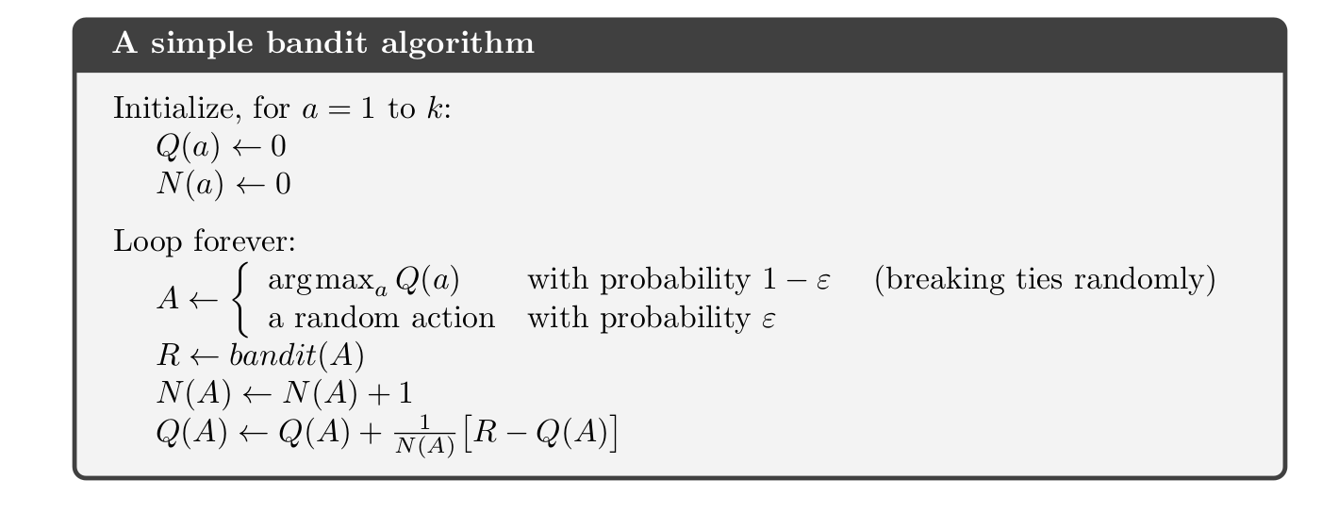
Epsilon greedy method

Slide 9
Comparison of different approaches using 10-armed test bed
10-armed test bed is a set of 2000 randomly generated k -armed bandit problems with k = 10.
For each bandit problem, such as shown in figure, the action values, q*(a), a = 1, . . . , 10 are selected according to a normal (Gaussian) distribution with mean 0 and variance 1.
Then, when a learning method applied to that problem selects action A_{t} at time step t, the actual reward, R_{t}, is selected from a normal distribution with mean q* (A_{t}) and variance 1.
For any learning method, we can measure its performance and behavior as it improves with experience over 1000 time steps when applied to one of the bandit problems. This makes up one run.
Repeating this for 2000 independent runs, each with a different bandit problem, we obtain measures of the learning algorithm’s average behavior.

Slide 10
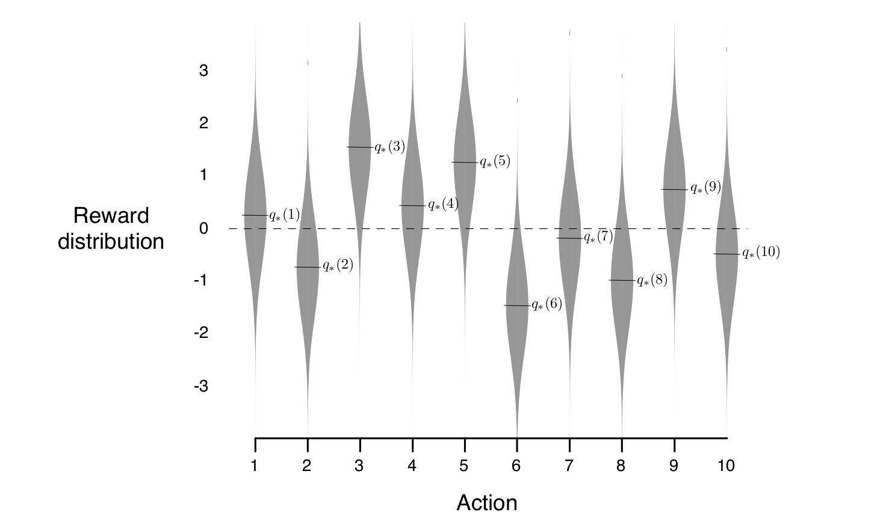
10-armed testbed

Slide 11
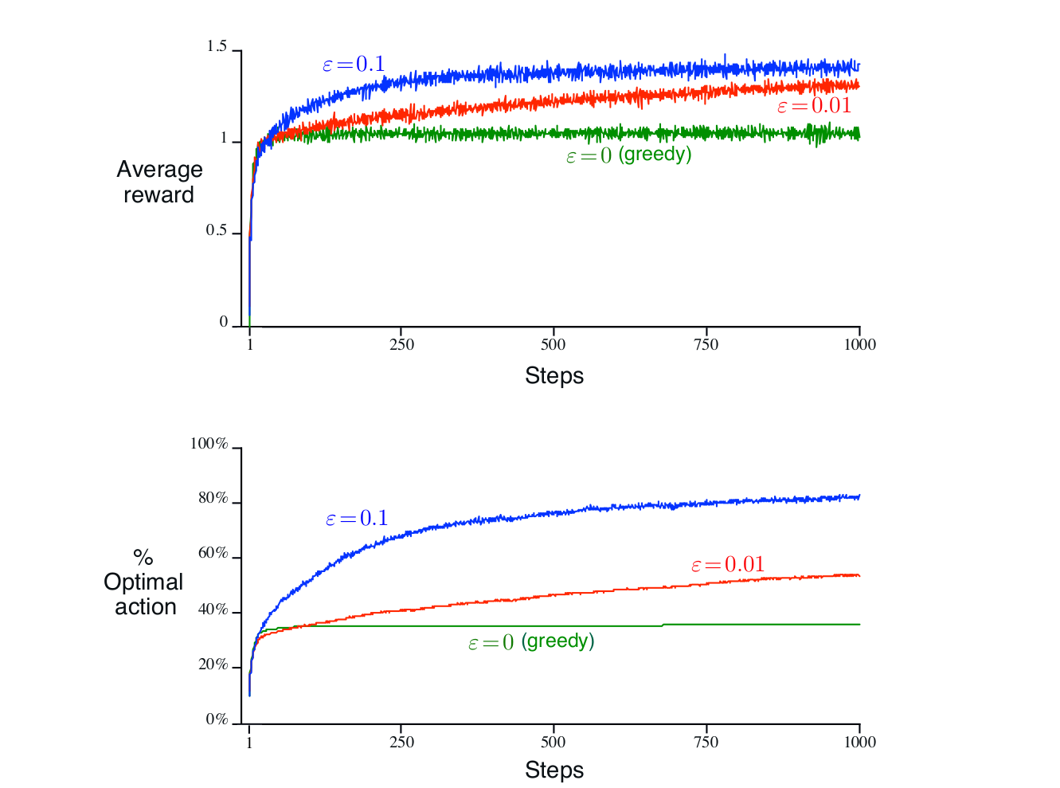
Comparison of greedy and epsilon-greedy methods

Slide 12

Tracking a Nonstationary Problem
Suppose the true action values change over time, then we say that the problem is non-stationary.
In such cases it makes sense to give more weight to recent rewards than to long-past rewards.
One of the most popular ways of doing this is to use a constant step-size parameter.
For example, the incremental update rule for updating an average Q_{n} of the n-1 past rewards is modified to be:
where the step-size parameter ⍺ (0, 1] is constant.

Slide 13
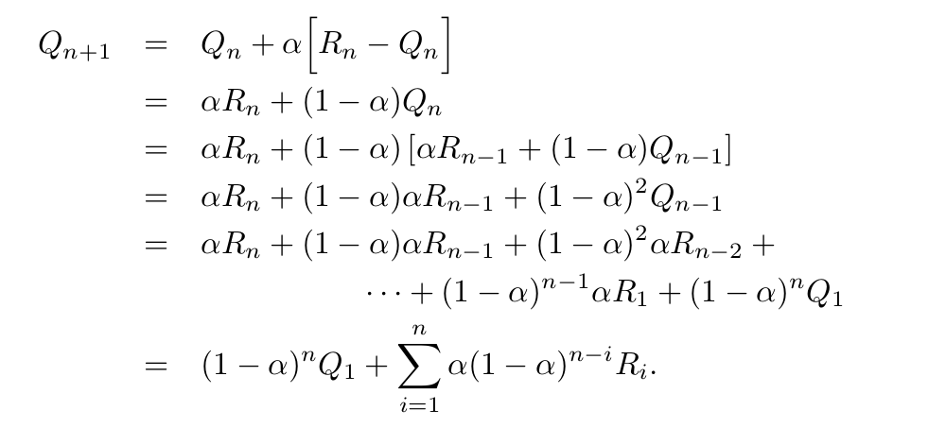
Tracking a Nonstationary Problem
Q_{n+1} is a weighted average of past rewards and the initial estimate Q₁

Slide 14
Tracking a Nonstationary Problem
The weight, ⍺(1-⍺)^{n-i}, given to the reward R_{i} depends on how many rewards ago, n-i, it was observed.
The quantity (1-⍺) is less than 1, and thus the weight given to R_{i} decreases as the number of intervening rewards increases.
In fact, the weight decays exponentially according to the exponent 1-⍺. (If 1-⍺= 0, then all the weight goes on the very last reward, R_{n}, because of the convention that 0⁰ = 1.)
Accordingly, this is sometimes called an exponential recency-weighted average.

